Slide 1

Frontend Web Development Bootcamp
week 6

Slide 2

Let’s play!
Download the server from github.
Run gradle build.
Start the server.
Connect the server to the FE by calling the get all users endpoint.

Slide 3

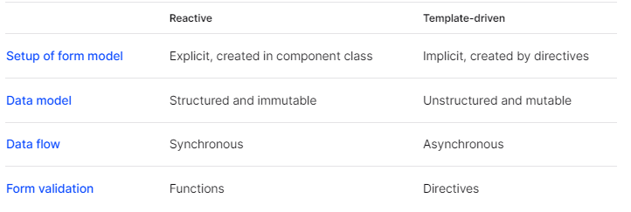
Forms
There are two types of forms in Angular:
Reactive forms
Provide direct access to the data model
Are more robust, scalable, reusable, testable (than template-driven forms)
Use reactive forms when forms are the key part of your app
Template driven forms
Provide access to the data model with directives
Are not as scalable as forms
Use template driven forms when the app has simple forms

Slide 4
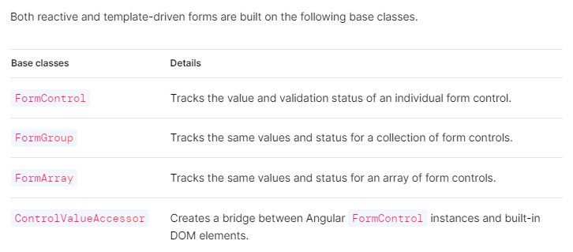

Forms Foundation

Slide 5
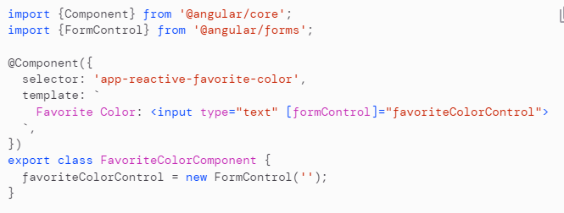
Reactive Forms vs Template Driven Forms
Reactive forms
The [formControl] directive in the <input> element provides a live status of the form element.

Slide 6
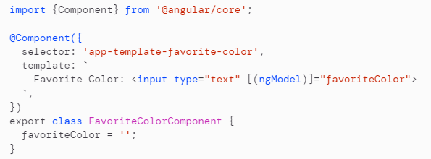
Reactive Forms vs Template Driven Forms
Template driven forms
Source of truth = template
NgModel manages the FormControl instance.

Slide 7
Reactive Forms
Setup:
Register the Forms Module in the app.
Generate a new component and instantiate new FormControl.
Register the FormControl in the template.

Slide 8
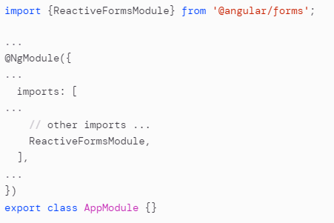
Reactive Forms
Setup:
Register the Forms Module in the app:

Slide 9
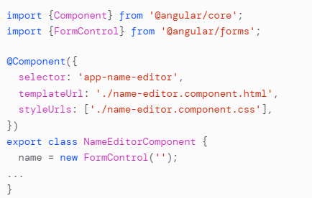
Reactive Forms
Setup:
Register the Forms Module in the app.
Generate a new component and instantiate new FormControl:

Slide 10
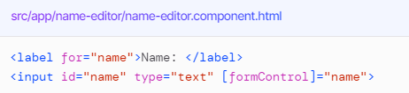
Reactive Forms
Setup:
Register the Forms Module in the app.
Generate a new component and instantiate new FormControl.
Register the FormControl in the template.

Slide 11
Let’s play!
Create a form control for the first name and display it.

Slide 12
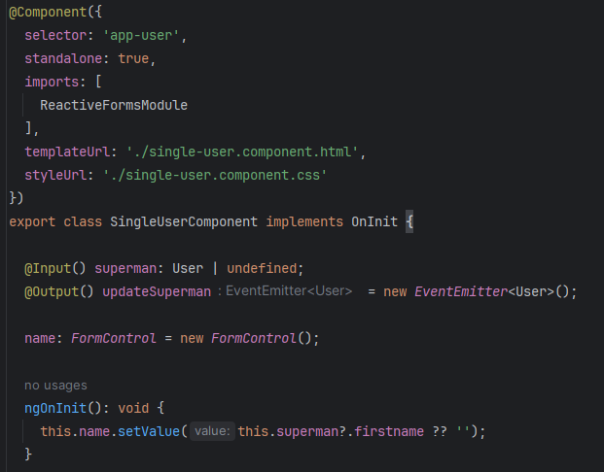

Let’s play!
Create a form control for the first name and display it.

Slide 13
Grouping Form Controls
Usually a form has more than one input => we need to group them.
There are two ways of grouping form controls:
FormGroup: has fixed set of controls
FormArray: controls can be added/removed
How to create a form group:
Create a form group instance
Associate it to a template

Slide 14
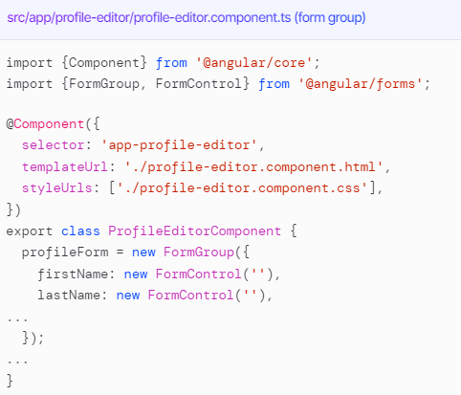
Grouping Form Controls
How to create a form group:
Create a form group instance

Slide 15
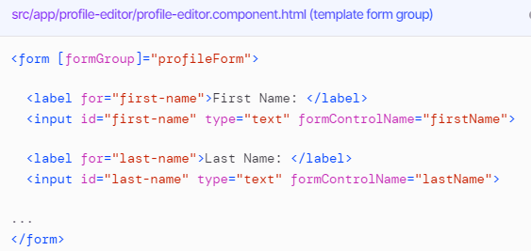
Grouping Form Controls
How to create a form group:
Create a form group instance
Associate it to a template

Slide 16
Let’s play!
Create a form group and display it.

Slide 17
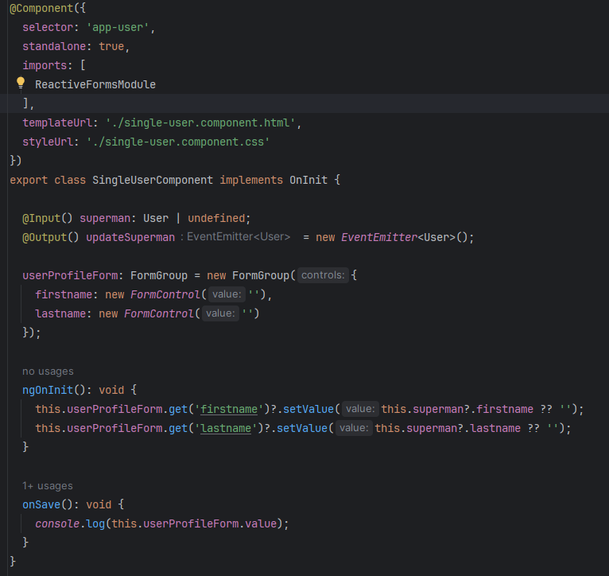
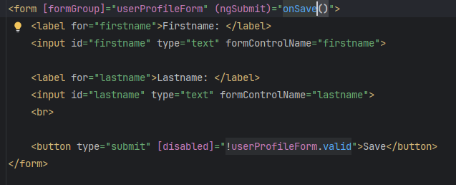
Let’s play!
Create a form group and display it.

Slide 18
Form Builder
When dealing with larger apps, with many forms, it can become repetitive to create form controls => we can use form builder. It provides various methods.
How to use form builder:
Inject the FormBuilder service
Generate the form controls using form builder

Slide 19

Form Builder
How to use form builder:
Inject the FormBuilder service

Slide 20
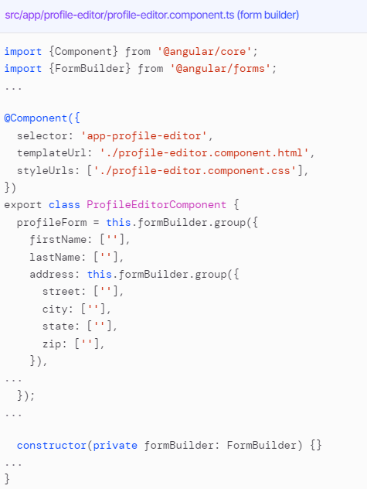
Form Builder
How to use form builder:
Inject the FormBuilder service
Generate the form controls using form builder

Slide 21
Let’s play!
Create the form group using the form builder.

Slide 22
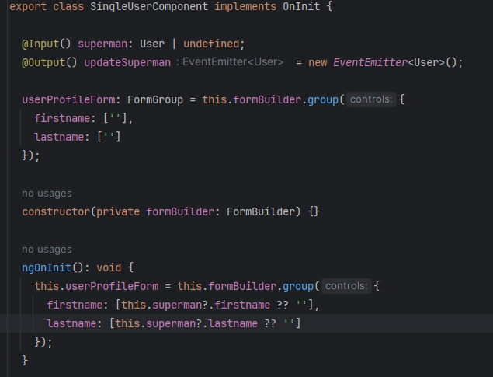
Let’s play!
Create the form group using the form builder.

Slide 23
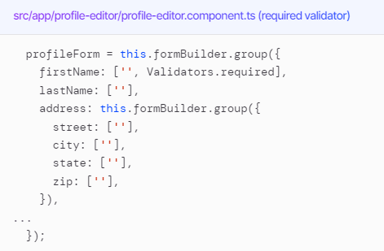
Validating Forms

Slide 24
Let’s play!
Add following validators:
For firstname, lastname -> required and min length 3 chars and max 15 chars
Email -> email

Slide 25
Let’s play!
Implement an update for each user (call the server update method from github).

Slide 26

Bye

